Slide 1
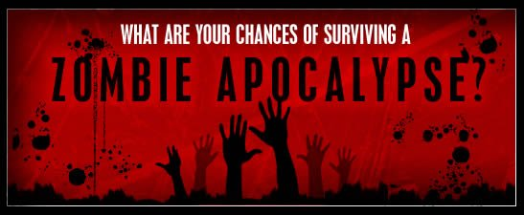
Apocalyptics
CDC Zombie Apocalypse Proposal
April 10th, 2015 - Revanth Garlapati, Trevor Smith, Brian Kim

Slide 2

Problem
Dr. Evil
-Infamous terrorist from the UK
-Ties with Al Qaeda, Iran, and North Korea
-3 attempts at world destruction in last 25 years
-attempts neutralized by now inactive
secret agent with MI-6
A spy in the organization has revealed that Dr. Evil plans to release a deadly biological agent in the NYC Subway in the next few weeks. The biological agent is believed to be a derivative of a chemical once thought to be the cure to cancer, but was later shown to cause Victus Mortuus, not only quickly killing humans but reviving them as Homo Necrosis Zombifis(aka: zombies).

Slide 3

Problem
It is believed that NYC was chosen because it has a population of more than 8.4 million people, with 3.1 million located in Manhattan during the day time (100,000/sq-mile).
An infection lies dormant for 1 day before symptoms show up (often misdiagnosed as Mad Cow Disease). It is believed that if an outbreak is not contained within 48 hours, the world’s population is at risk.

Slide 4
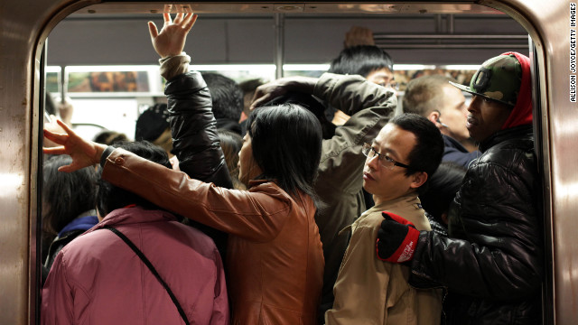
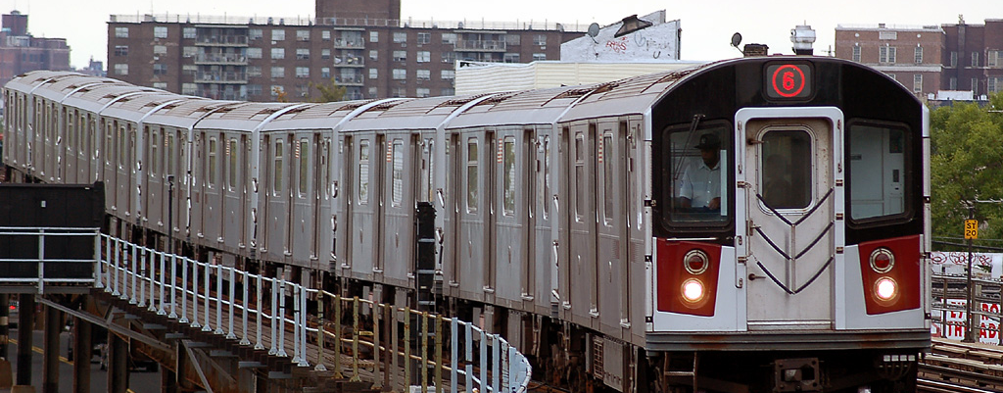
Why the Subway System?
The CDC has reason to believe that this attack will likely be started in one of the NYC Subway Stations. With an an average ridership of 2.5mil-5.5mil per day; the disease could spread very quickly throughout the city through this channel because of the number of riders at any given time, the large number of transfers, and the deep network of subway stations located in the five boroughs.

Slide 5
Initial Findings

Slide 6

Stations with Most Foot Traffic
Station Name
Penn Station
Grand Central
Herald Square
Port Authority
Times Square
Number of Riders (millions)

Slide 7
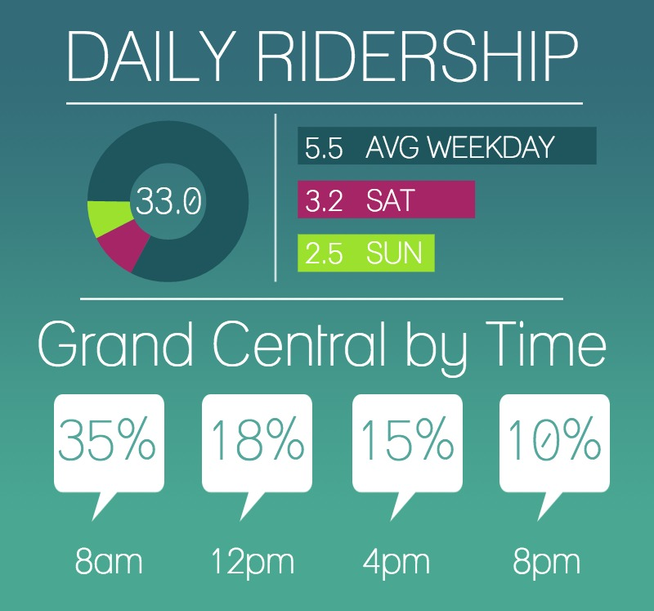
Entries by Day
Weekdays are much more
popular than weekends
-5.5 million riders on an average weekday
-3 millions average riders on an average weekend day
Mornings are busier than afternoons or nights
-nearly 50% of all traffic is during the morning commute time
*data in millions unless otherwise noted

Slide 8
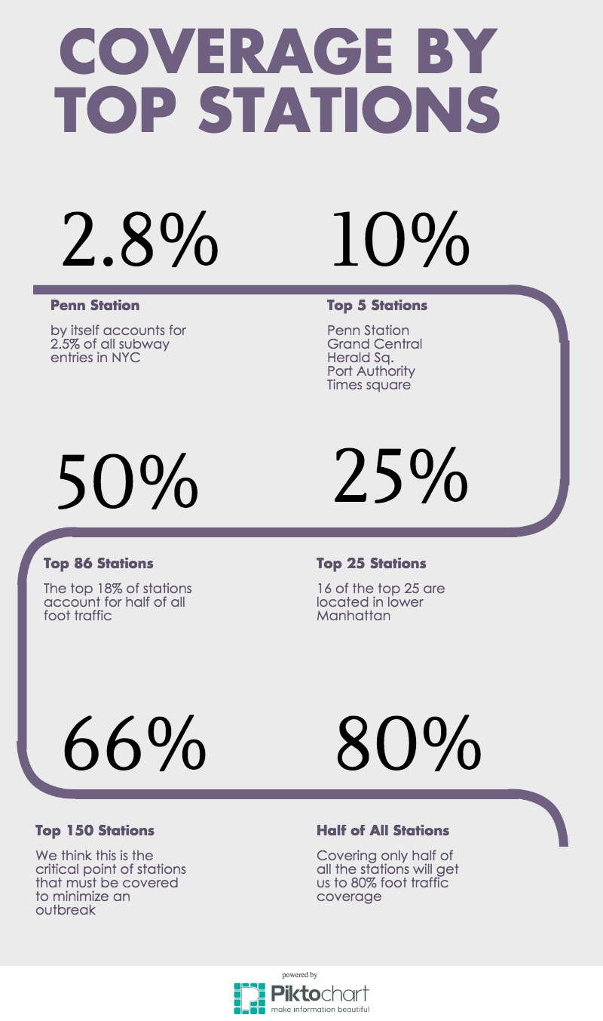
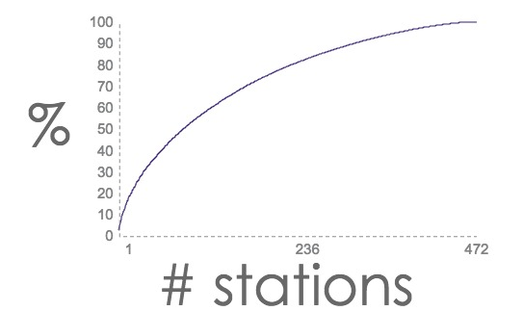
Coverage Distribution
The top 5 stations cover 10%
The top 86 stations cover 50%
Half of all stations cover 80%

Slide 9
Next Steps

Slide 10

Proposed Solution
-By analyzing MTA Subway data as well as incorporating a few other data sources we can prevent / minimize the effects of a zombie outbreak.
-By understanding the most at risk areas/times, the CDC will be able to efficiently staff, police officers and other resources.
-Also, if an outbreak does occur, our interactive heatgraph map of NYC will update to show where to stream resources and which stations to completely shut down in order to contain the outbreak.
Notes:
While the MTA data provides us with a reasonably good preliminary understanding of the potential risks associated with various places in NY, we need to carry out more detailed analysis to get a better understanding of the risk map. This map could be used to allocate various resources to counter the threat as well as identify the stations that could be closed to contain the outbreak.

Slide 11
Other useful data sources
Other data sources:
Street traffic index
MTA record based spread models
Twitter / FB / Instagram
New York City Council data on population densities.
Pedestrian/Traffic data
Weather data and its impact on virus spread
Information on spread mechanism
Notes:
There are other factors that impact the spread of the outbreak, for example street traffic. We could simulate the outbreak spread and generate
risk maps. We could create an online tool that tracks the information regarding outbreak on social networking sites. Population densities of
regions could also provide further insight into the risk maps. Further information on the environment that is conducive for the spread of the mechanism
is could prove useful.

Slide 12
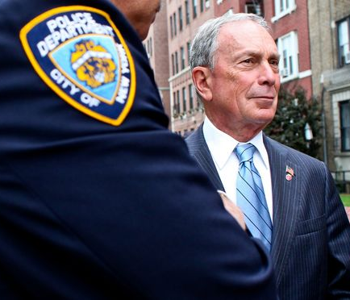
NYPD Army
“I have my own army in the NYPD, which is the seventh biggest army in the world.”
Mayor Bloomberg
There are over 34,000 NYPD officers
Notes:
the next steps are to perform a detailed analysis and chalk out a response plan. Of course, NY is well equipped to handle such a crisis as illustrated by the aforementioned statement of the former mayor. Although, not very close to the reality, the statement does have a point. In this segment I discuss plan for the study, possible additional sources of data, outcome of the analysis and how it would be used to respond.

Slide 13
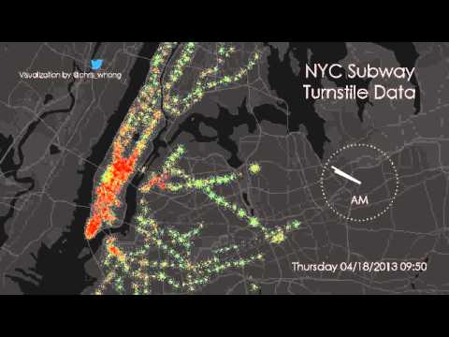
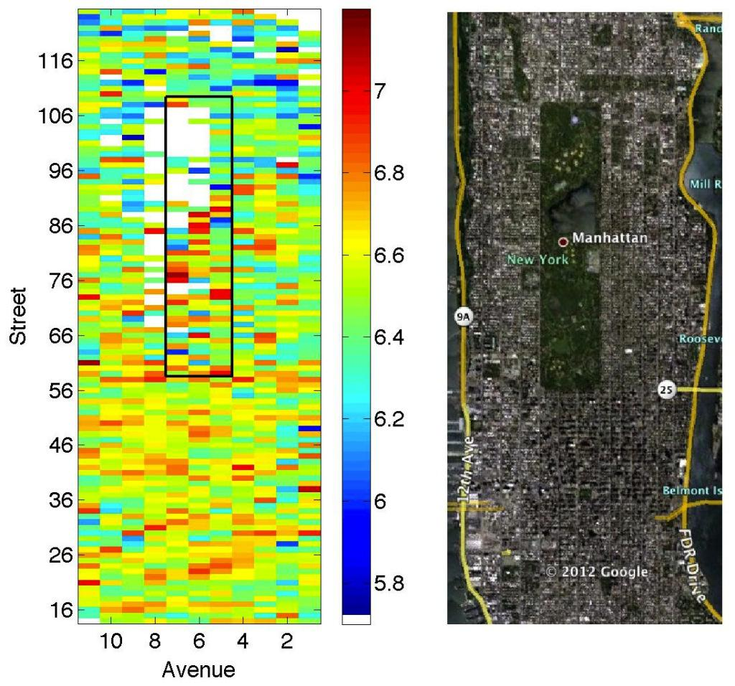
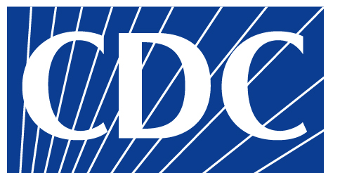


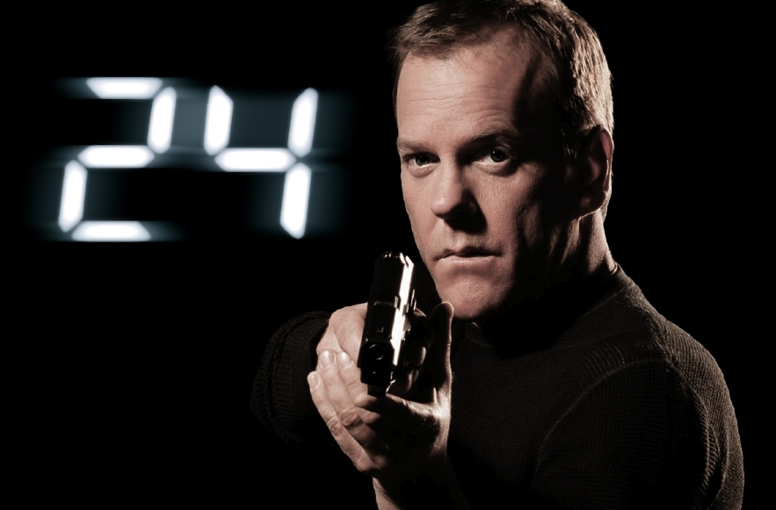
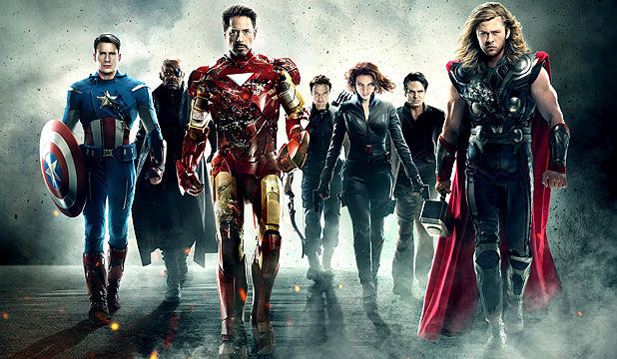
Risk map of NYC
Risk / Danger Level
Notes:
Here is an example of the time-varying potential risk map. The resources could be allocated accordingly. The first teams to respond would be the
CDC and the police. If the A-team fails we could rely on ghostbusters or counter terrorism officers such as Jack Bauer. If everything fails we could fall back on avengers.

